Slide 1
안드로이드 실무 10주차 과제
1901055 정시철

Slide 2
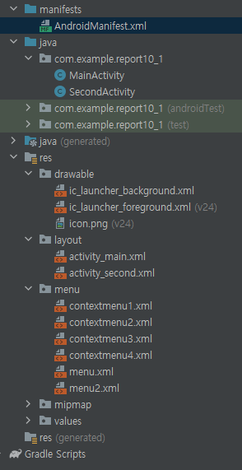
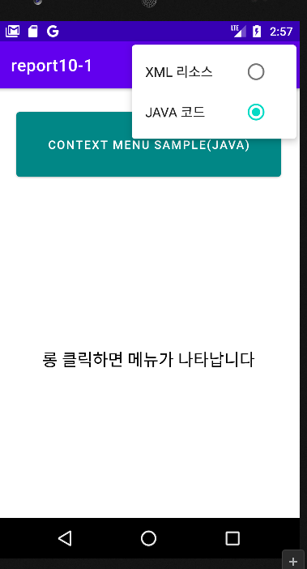
Report 1 Menu 응용
<?xml version="1.0" encoding="utf-8"?> <LinearLayout xmlns:android="http://schemas.android.com/apk/res/android" xmlns:tools="http://schemas.android.com/tools" android:layout_width="match_parent" android:layout_height="match_parent" tools:context=".MainActivity" android:orientation="vertical"> <Button android:layout_width="match_parent" android:layout_height="40pt" android:layout_margin="10pt" android:text="Context Menu Sample(XML)" android:gravity="center" android:layout_gravity="top" android:textColor="@color/white" android:backgroundTint="@color/teal_700"/> <TextView android:id="@+id/textView" android:layout_width="match_parent" android:layout_height="match_parent" android:gravity="center" android:text="롱 클릭하면 메뉴가 나타납니다" android:textColor="@color/black" android:textSize="20dp" /> </LinearLayout>
<?xml version="1.0" encoding="utf-8"?> <LinearLayout xmlns:android="http://schemas.android.com/apk/res/android" xmlns:tools="http://schemas.android.com/tools" android:layout_width="match_parent" android:layout_height="match_parent" tools:context=".SecondActivity" android:orientation="vertical"> <Button android:layout_width="match_parent" android:layout_height="40pt" android:layout_margin="10pt" android:text="Context Menu Sample(JAVA)" android:gravity="center" android:layout_gravity="top" android:textColor="@color/white" android:backgroundTint="@color/teal_700"/> <TextView android:id="@+id/textView" android:layout_width="match_parent" android:layout_height="match_parent" android:gravity="center" android:text="롱 클릭하면 메뉴가 나타납니다" android:textColor="@color/black" android:textSize="20dp" /> </LinearLayout>
<?xml version="1.0" encoding="utf-8"?> <menu xmlns:android="http://schemas.android.com/apk/res/android"> <group android:checkableBehavior="single" android:enabled="true"> <item android:id="@+id/black" android:checked="true" android:title="검정" /> <item android:id="@+id/red" android:title="빨강" /> <item android:id="@+id/green" android:title="녹색" /> <item android:id="@+id/blue" android:title="파랑" /> </group> </menu>
<?xml version="1.0" encoding="utf-8"?> <menu xmlns:android="http://schemas.android.com/apk/res/android"> <group android:checkableBehavior="single" android:enabled="true"> <item android:id="@+id/black" android:title="검정" /> <item android:id="@+id/red" android:checked="true" android:title="빨강" /> <item android:id="@+id/green" android:title="녹색" /> <item android:id="@+id/blue" android:title="파랑" /> </group> </menu>
<?xml version="1.0" encoding="utf-8"?> <menu xmlns:android="http://schemas.android.com/apk/res/android"> <group android:checkableBehavior="single" android:enabled="true"> <item android:id="@+id/black" android:title="검정" /> <item android:id="@+id/red" android:title="빨강" /> <item android:id="@+id/green" android:checked="true" android:title="녹색" /> <item android:id="@+id/blue" android:title="파랑" /> </group> </menu>
메인
세컨드
<?xml version="1.0" encoding="utf-8"?> <menu xmlns:android="http://schemas.android.com/apk/res/android"> <group android:checkableBehavior="single" android:enabled="true"> <item android:id="@+id/black" android:title="검정" /> <item android:id="@+id/red" android:title="빨강" /> <item android:id="@+id/green" android:title="녹색" /> <item android:id="@+id/blue" android:checked="true" android:title="파랑" /> </group> </menu>
package com.example.report10_1; import androidx.annotation.NonNull; import androidx.appcompat.app.AppCompatActivity; import android.content.Intent; import android.graphics.Color; import android.os.Bundle; import android.view.ContextMenu; import android.view.Menu; import android.view.MenuInflater; import android.view.MenuItem; import android.view.View; import android.widget.TextView; public class MainActivity extends AppCompatActivity { TextView textView; int index = 0; boolean type = true; int[] id = new int[]{R.menu.contextmenu1, R.menu.contextmenu2, R.menu.contextmenu3, R.menu.contextmenu4}; @Override public boolean onCreateOptionsMenu(Menu menu) { MenuInflater inflater = getMenuInflater(); inflater.inflate(R.menu.menu,menu); return super.onCreateOptionsMenu(menu); } @Override public boolean onOptionsItemSelected(@NonNull MenuItem item) { if (item.getItemId()==R.id.javac){ Intent intent = new Intent(MainActivity.this,SecondActivity.class); startActivity(intent);} return super.onOptionsItemSelected(item); } @Override protected void onCreate(Bundle savedInstanceState) { super.onCreate(savedInstanceState); setContentView(R.layout.activity_main); textView = findViewById(R.id.textView); registerForContextMenu(textView); } @Override public void onCreateContextMenu(ContextMenu menu, View v, ContextMenu.ContextMenuInfo menuInfo) { MenuInflater menuInflater = getMenuInflater(); menu.setHeaderTitle("글자색"); menu.setHeaderIcon(R.drawable.icon); menuInflater.inflate(id[index], menu); } @Override public boolean onContextItemSelected(MenuItem item) { switch (item.getItemId()) { case R.id.black: textView.setTextColor(Color.BLACK);index = 0;break; case R.id.red:// 빨강 메뉴 선택시 textView.setTextColor(Color.RED);index = 1;break; case R.id.green:// 녹색 메뉴 선택시 textView.setTextColor(Color.GREEN);index = 2;break; case R.id.blue:// 파랑 메뉴 선택시 textView.setTextColor(Color.BLUE);index = 3; } return super.onContextItemSelected(item); }}
package com.example.report10_1; import androidx.annotation.NonNull; import androidx.appcompat.app.AppCompatActivity; import android.content.ClipData; import android.content.Intent; import android.graphics.Color; import android.os.Bundle; import android.view.ContextMenu; import android.view.Menu; import android.view.MenuInflater; import android.view.MenuItem; import android.view.View; import android.widget.TextView; public class SecondActivity extends AppCompatActivity { TextView textView; int index = 1; @Override public boolean onCreateOptionsMenu(Menu menu) { MenuInflater inflater = getMenuInflater(); inflater.inflate(R.menu.menu2,menu); return super.onCreateOptionsMenu(menu); } @Override public boolean onOptionsItemSelected(@NonNull MenuItem item) { if (item.getItemId()==R.id.xmlr){ finish();} return super.onOptionsItemSelected(item); } @Override protected void onCreate(Bundle savedInstanceState) { super.onCreate(savedInstanceState); setContentView(R.layout.activity_second); textView = findViewById(R.id.textView); registerForContextMenu(textView); } @Override public void onCreateContextMenu(ContextMenu menu, View v, ContextMenu.ContextMenuInfo menuInfo) { menu.setHeaderTitle("글자색"); if (index == 1) menu.add(1, 1, 0, "검정").setChecked(true); else menu.add(1, 1, 0, "검정"); if (index == 2) menu.add(1, 2, 0, "빨강").setChecked(true); else menu.add(1, 2, 0, "빨강"); if (index == 3) menu.add(1, 3, 0, "녹색").setChecked(true); else menu.add(1, 3, 0, "녹색"); if (index == 4) menu.add(1, 4, 0, "파랑").setChecked(true); else menu.add(1, 4, 0, "파랑"); menu.setGroupCheckable(1, true, true); } @Override public boolean onContextItemSelected(MenuItem item) { switch (item.getItemId()) { case 1: textView.setTextColor(Color.BLACK);index = 1;break; case 2:// 빨강 메뉴 선택시 textView.setTextColor(Color.RED);index = 2;break; case 3:// 녹색 메뉴 선택시 textView.setTextColor(Color.GREEN);index = 3;break; case 4:// 파랑 메뉴 선택시 textView.setTextColor(Color.BLUE);index = 4; } return super.onContextItemSelected(item); }}
내용이 조금 난잡할 수 있습니다.
그냥 수업자료의 예제를 보이는 그대로 응용했습니다.
콘텍스트메뉴 4개
<?xml version="1.0" encoding="utf-8"?> <menu xmlns:android="http://schemas.android.com/apk/res/android"> <group android:checkableBehavior="single" android:enabled="true"> <item android:id="@+id/xmlr" android:checked="true" android:title="XML 리소스" /> <item android:id="@+id/javac" android:title="JAVA 코드" /> </group> </menu>
<?xml version="1.0" encoding="utf-8"?> <menu xmlns:android="http://schemas.android.com/apk/res/android"> <group android:checkableBehavior="single" android:enabled="true"> <item android:id="@+id/xmlr" android:title="XML 리소스" /> <item android:id="@+id/javac" android:checked="true" android:title="JAVA 코드" /> </group> </menu>
그냥메뉴 2개

Slide 3
Report 2 Pop메뉴
package com.example.report10_2; import androidx.annotation.NonNull; import androidx.appcompat.app.AppCompatActivity; import android.os.Bundle; import android.view.Menu; import android.view.MenuInflater; import android.view.MenuItem; import android.view.View; import android.widget.Button; import android.widget.PopupMenu; import android.widget.Toast; public class MainActivity extends AppCompatActivity { Button button; PopupMenu popupMenu; @Override public boolean onCreateOptionsMenu(Menu menu) { MenuInflater inflater = getMenuInflater(); inflater.inflate(R.menu.menu, menu); return super.onCreateOptionsMenu(menu); } @Override protected void onCreate(Bundle savedInstanceState) { super.onCreate(savedInstanceState); setContentView(R.layout.activity_main); button = findViewById(R.id.button); button.setOnLongClickListener(new View.OnLongClickListener() { @Override public boolean onLongClick(View view) { popupMenu.show();return true; }}); popupMenu = new PopupMenu(this, button); popupMenu.getMenuInflater().inflate(R.menu.popupmenu, popupMenu.getMenu()); popupMenu.setOnMenuItemClickListener(new PopupMenu.OnMenuItemClickListener() { @Override public boolean onMenuItemClick(MenuItem Item) { switch (Item.getItemId()){ case R.id.white: case R.id.red: case R.id.blue: Toast.makeText(getApplicationContext(), "팝업메뉴 이벤트 처리 - " + Item.getTitle(), Toast.LENGTH_SHORT).show();break; case R.id.green: case R.id.text1: Toast.makeText(getApplicationContext(), "팝업메뉴 이벤트 처리 - " + Item.getTitle(), Toast.LENGTH_SHORT).show();break; case R.id.text2: Toast.makeText(getApplicationContext(), "팝업메뉴 이벤트 처리 - " + Item.getTitle(), Toast.LENGTH_SHORT).show();break; case R.id.text3: Toast.makeText(getApplicationContext(), "팝업메뉴 이벤트 처리 - " + Item.getTitle(), Toast.LENGTH_SHORT).show();break; case R.id.bgm: }Item.setChecked(true);return false; }}); } @Override public boolean onOptionsItemSelected(@NonNull MenuItem item) { switch (item.getItemId()){ case R.id.white: Toast.makeText(getApplicationContext(), "옵션메뉴 이벤트 처리 - " + item.getTitle(), Toast.LENGTH_SHORT).show();break; case R.id.red: Toast.makeText(getApplicationContext(), "옵션메뉴 이벤트 처리 - " + item.getTitle(), Toast.LENGTH_SHORT).show();break; case R.id.blue: Toast.makeText(getApplicationContext(), "옵션메뉴 이벤트 처리 - " + item.getTitle(), Toast.LENGTH_SHORT).show();break; case R.id.green: Toast.makeText(getApplicationContext(), "옵션메뉴 이벤트 처리 - " + item.getTitle(), Toast.LENGTH_SHORT).show();break; case R.id.text1: Toast.makeText(getApplicationContext(), "옵션메뉴 이벤트 처리 - " + item.getTitle(), Toast.LENGTH_SHORT).show();break; case R.id.text2: Toast.makeText(getApplicationContext(), "옵션메뉴 이벤트 처리 - " + item.getTitle(), Toast.LENGTH_SHORT).show();break; case R.id.text3: Toast.makeText(getApplicationContext(), "옵션메뉴 이벤트 처리 - " + item.getTitle(), Toast.LENGTH_SHORT).show();break; case R.id.bgm: Toast.makeText(getApplicationContext(), "옵션메뉴 이벤트 처리 - " + item.getTitle(), Toast.LENGTH_SHORT).show();break; } item.setChecked(true);return super.onOptionsItemSelected(item); }}
<?xml version="1.0" encoding="utf-8"?> <LinearLayout xmlns:android="http://schemas.android.com/apk/res/android" xmlns:tools="http://schemas.android.com/tools" android:id="@+id/lin" android:layout_width="match_parent" android:layout_height="match_parent" android:orientation="vertical" tools:context=".MainActivity"> <TextView android:layout_width="match_parent" android:layout_height="wrap_content" android:gravity="center" android:padding="10dp" android:text="버튼 클릭시 PopUp 메뉴가 나타납니다."/> <Button android:id="@+id/button" android:layout_width="match_parent" android:layout_height="wrap_content" android:text="POPUP 메뉴"/> </LinearLayout>
<?xml version="1.0" encoding="utf-8"?> <menu xmlns:android="http://schemas.android.com/apk/res/android" xmlns:app="http://schemas.android.com/apk/res-auto"> <item android:id="@+id/menu1" android:title="배경색 변경"> <menu> <group android:checkableBehavior="single"> <item android:id="@+id/white" android:title="하얀색" /> <item android:id="@+id/red" android:title="빨강색" /> <item android:id="@+id/blue" android:title="파란색" /> <item android:id="@+id/green" android:title="초록색" /> </group> </menu> </item> <item android:id="@+id/menu2" android:title="글자색 변경"> <menu> <group android:checkableBehavior="single"> <item android:id="@+id/text1" android:title="글자색 - 하얀" /> <item android:id="@+id/text2" android:title="글자 - 검정" /> <item android:id="@+id/text3" android:title="글자 - 노랑" /> </group> </menu> </item> <item android:id="@+id/bgm" android:checkable="true" android:checked="false" android:title="배경음악 ON/OFF"/> </menu>
<?xml version="1.0" encoding="utf-8"?> <menu xmlns:android="http://schemas.android.com/apk/res/android"> <item android:id="@+id/menu1" android:title="배경색 변경"> <menu> <group android:checkableBehavior="single"> <item android:id="@+id/white" android:title="하얀색" /> <item android:id="@+id/red" android:title="빨강색" /> <item android:id="@+id/blue" android:title="파란색" /> <item android:id="@+id/green" android:title="초록색" /> </group> </menu> </item> <item android:id="@+id/menu2" android:title="글자색 변경"> <menu> <group android:checkableBehavior="single"> <item android:id="@+id/text1" android:title="글자색 - 하얀" /> <item android:id="@+id/text2" android:title="글자 - 검정" /> <item android:id="@+id/text3" android:title="글자 - 노랑" /> </group> </menu> </item> <item android:id="@+id/bgm" android:checkable="true" android:checked="false" android:title="배경음악 ON/OFF"/> </menu>
메인 레이아웃
main.xml
popupmain
메인 엑티비티

Slide 4
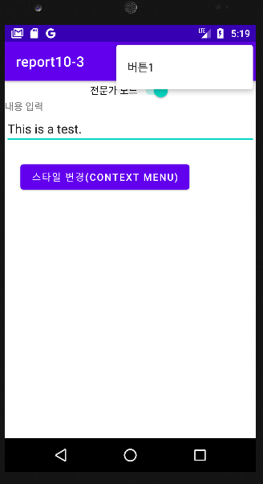
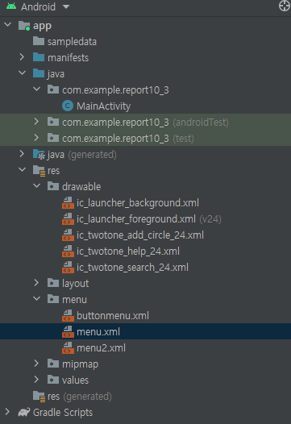
Report 3 Menu 액션바 응용
package com.example.report10_3; import androidx.appcompat.app.ActionBar; import androidx.appcompat.app.AppCompatActivity; import androidx.core.internal.view.SupportMenuItem; import android.graphics.Color; import android.graphics.drawable.ColorDrawable; import android.os.Bundle; import android.view.Menu; import android.view.MenuInflater; import android.view.MenuItem; import android.view.View; import android.widget.Button; import android.widget.CompoundButton; import android.widget.EditText; import android.widget.PopupMenu; import android.widget.Switch; import android.widget.Toast; public class MainActivity extends AppCompatActivity { Button button; PopupMenu popupMenu; ActionBar actionBar; EditText edit; boolean a = false; @Override public boolean onCreateOptionsMenu(Menu menu) { MenuInflater inflater = getMenuInflater(); if (a==true) inflater.inflate(R.menu.menu2,menu); else inflater.inflate(R.menu.menu,menu); return super.onCreateOptionsMenu(menu); } @Override protected void onCreate(Bundle savedInstanceState) { super.onCreate(savedInstanceState); setContentView(R.layout.activity_main); edit = findViewById(R.id.edit); actionBar = getSupportActionBar(); Switch toggle = findViewById(R.id.switch1); toggle.setOnCheckedChangeListener(new CompoundButton.OnCheckedChangeListener() { @Override public void onCheckedChanged(CompoundButton compoundButton, boolean b) { if (b){ a = true;invalidateOptionsMenu(); }else { a = false;invalidateOptionsMenu(); } }}); button = findViewById(R.id.button); button.setOnLongClickListener(new View.OnLongClickListener() { @Override public boolean onLongClick(View view) { popupMenu.show();return true; }}); button.setOnClickListener(new View.OnClickListener() { @Override public void onClick(View view) { Toast.makeText(MainActivity.this, "버튼을 클릭했습니다.", Toast.LENGTH_SHORT).show(); }}); popupMenu = new PopupMenu(this, button); popupMenu.getMenuInflater().inflate(R.menu.buttonmenu,popupMenu.getMenu()); popupMenu.setOnMenuItemClickListener(new PopupMenu.OnMenuItemClickListener() { @Override public boolean onMenuItemClick(MenuItem menuItem) { switch (menuItem.getItemId()){ case R.id.gray: edit.setBackgroundColor(Color.parseColor("#aaaaaa"));break; case R.id.cyan: edit.setBackgroundColor(Color.parseColor("#00a3d2"));break; case R.id.red: edit.setBackgroundColor(Color.parseColor("#ff0000"));break; case R.id.white: edit.setBackgroundColor(Color.parseColor("#ffffff"));break; case R.id.item1: edit.setTextColor(Color.parseColor("#0000ff"));break; case R.id.item2: edit.setTextSize(30);break; case R.id.item3: edit.setTextSize(18);break; }return false; }}); }}
<?xml version="1.0" encoding="utf-8"?> <menu xmlns:android="http://schemas.android.com/apk/res/android"> <item android:title="EditText 변경"> <menu> <group android:checkableBehavior="single"> <item android:id="@+id/gray" android:title="회색"/> <item android:id="@+id/cyan" android:title="시안색"/> <item android:id="@+id/red" android:title="빨간색"/> <item android:id="@+id/white" android:checked="true" android:title="흰색"/> </group> </menu> </item> <item android:id="@+id/item1" android:title="글자색 - 파랑"/> <item android:id="@+id/item2" android:title="글자크기(확대)"/> <item android:id="@+id/item3" android:title="글자크기(원본)"/> </menu>
팝업메뉴
메인 액티비티
<?xml version="1.0" encoding="utf-8"?> <menu xmlns:android="http://schemas.android.com/apk/res/android" xmlns:app="http://schemas.android.com/apk/res-auto"> <item android:id="@+id/action1" android:title="버튼1" android:icon="@drawable/ic_twotone_help_24" app:showAsAction="always"/> <item android:id="@+id/action2" android:title="버튼2" android:icon="@drawable/ic_twotone_add_circle_24" app:showAsAction="never" /> <item android:id="@+id/action3" android:icon="@drawable/ic_twotone_search_24" app:showAsAction="never" android:title="버튼3" /> </menu>
<?xml version="1.0" encoding="utf-8"?> <LinearLayout xmlns:android="http://schemas.android.com/apk/res/android" xmlns:app="http://schemas.android.com/apk/res-auto" xmlns:tools="http://schemas.android.com/tools" android:layout_width="match_parent" android:layout_height="match_parent" android:orientation="vertical" tools:context=".MainActivity"> <Switch android:id="@+id/switch1" android:layout_width="wrap_content" android:layout_height="wrap_content" android:layout_gravity="center" android:gravity="center" android:text="전문가 모드" /> <TextView android:layout_width="match_parent" android:layout_height="wrap_content" android:text="내용 입력" /> <EditText android:textSize="18dp" android:id="@+id/edit" android:layout_width="match_parent" android:layout_height="wrap_content" android:text="This is a test." /> <Button android:id="@+id/button" android:layout_width="wrap_content" android:layout_height="wrap_content" android:layout_margin="10pt" android:text="스타일 변경(CONTEXT MENU)" /> </LinearLayout>
옵션메뉴 1,2
<?xml version="1.0" encoding="utf-8"?> <menu xmlns:android="http://schemas.android.com/apk/res/android" xmlns:app="http://schemas.android.com/apk/res-auto"> <item android:id="@+id/action1" android:title="버튼1" android:icon="@drawable/ic_twotone_help_24" app:showAsAction="never"/> <item android:id="@+id/action2" android:title="버튼2" android:icon="@drawable/ic_twotone_add_circle_24" app:showAsAction="always" /> <item android:id="@+id/action3" android:icon="@drawable/ic_twotone_search_24" app:showAsAction="always" android:title="버튼3" /> </menu>

